Slide 1
IS-456: Database Management Systems
Module 1: Enterprise Database Management Systems
Fall 2020
CityU
of Seattle
Farzin Bahadori

Slide 2
Topics
What is Database Management System?
Brief History
Why Use a DBMS?
Purpose of DBMS
Data models
Architecture of DBMS
levels or layers of DBMS architecture
Components of DBMS
Advantage of DBMS
Disadvantage of DBMS
DBMS Languages
References
CityU
of Seattle
Farzin Bahadori

Slide 3
What is Database Management System?
Definition: Collection of programs that manages the database structure and controls access to the data stored in database.
A Database Management System (DBMS), or simply a Database System (DBS) consist of :
A collection of interrelated and persistent data (usually referred to as the database (DB)).
A set of application programs used to access, update and manage that data (which form the data management system (MS)).
CityU
of Seattle
Farzin Bahadori

Slide 4
Brief History
Early 1960s: first general purpose database by Charles Bachman from GE. Used the network data model.
Late 1960s: IBM developed Information Management System (IMS). Used the hierarchical data model. Led to SABRE, the airline reservation system developed by AA and IBM. Still in use today.
1970: Edgar Code of IBM developed the relational data model. Led to several DBMS based on relational model, as well as important theoretical results. Code wins Turing award.
1980s: relational model dominant. SQL standard.
Late 1980s, 1990s: DBMS vendors extend systems, allowing more complex data types (images, text).
CityU
of Seattle
Farzin Bahadori

Slide 5
Role and Advantages of the DBMS
Reduced application development time.
Uniform data administration.
Concurrent access, recovery from crashes.
Improved data sharing
Security
Integration
Inconsistency
Data independence and efficient access
Improved decision making
Increased end-user productivity
CityU
of Seattle
Farzin Bahadori

Slide 6
Disadvantages of DBMS
Complexity
Skilled resources
Performance tunning
Database Failure
Cost
Additional hardware cost
Frequent upgrades
CityU
of Seattle
Farzin Bahadori

Slide 7
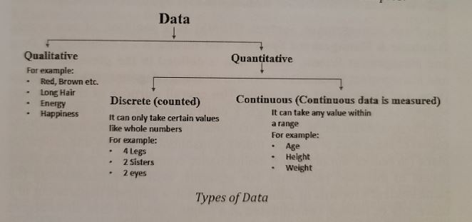
Types of Databases
Qualitative
Quantitative
CityU
of Seattle
Farzin Bahadori

Slide 8
Types of Databases Cont.
Single-user database
Multiuser database
Workgroup database
Enterprise database
Location
Centralized database
Distributed database
Cloud database
CityU
of Seattle
Farzin Bahadori

Slide 9
Types of Databases Cont.
General purpose database
Discipline-Specific database
Operational database
Analytical database
Data warehouse
Online analytical processing
Unstructured data
Structured data
Unstructured and semi-structured data → XML
CityU
of Seattle
Farzin Bahadori

Slide 10
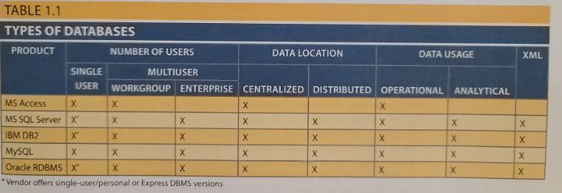
Types of Databases Cont.
CityU
of Seattle
Farzin Bahadori

Slide 11
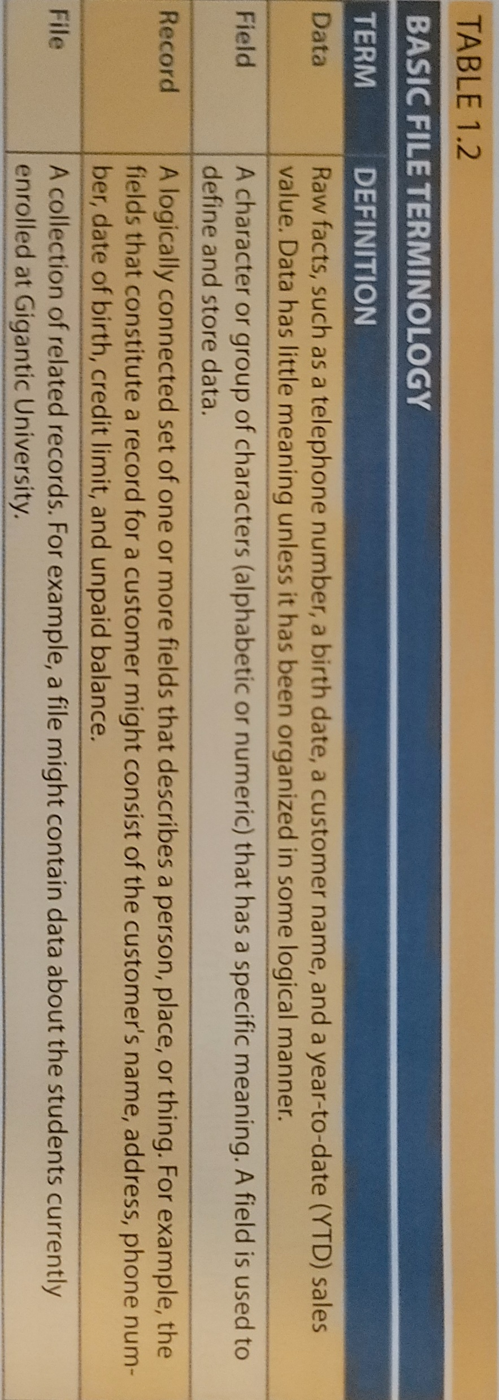
File System Data Processing
Manual File Systems
Computerized File Systems → DP Specialist
CityU
of Seattle
Farzin Bahadori

Slide 12
Summary
DBMS
Advantages and Disadvantages
Types
Centralized & Decentralized
Unstructured, Structured & Semi-Structured data
File Systems Data Processing
CityU
of Seattle
Farzin Bahadori

Slide 13

CityU
of Seattle
Farzin Bahadori

Slide 14
Resources
Mukesh Negi, (2019): Fundamental of Database Management System
Coronel C., Morris S., (2019): Database Systems, Design, Implementation, & Management
Adham Saeed, (2017): Role of Database Management Systems in Supporting Information Technology
CityU
of Seattle
Farzin Bahadori

